Slide 1

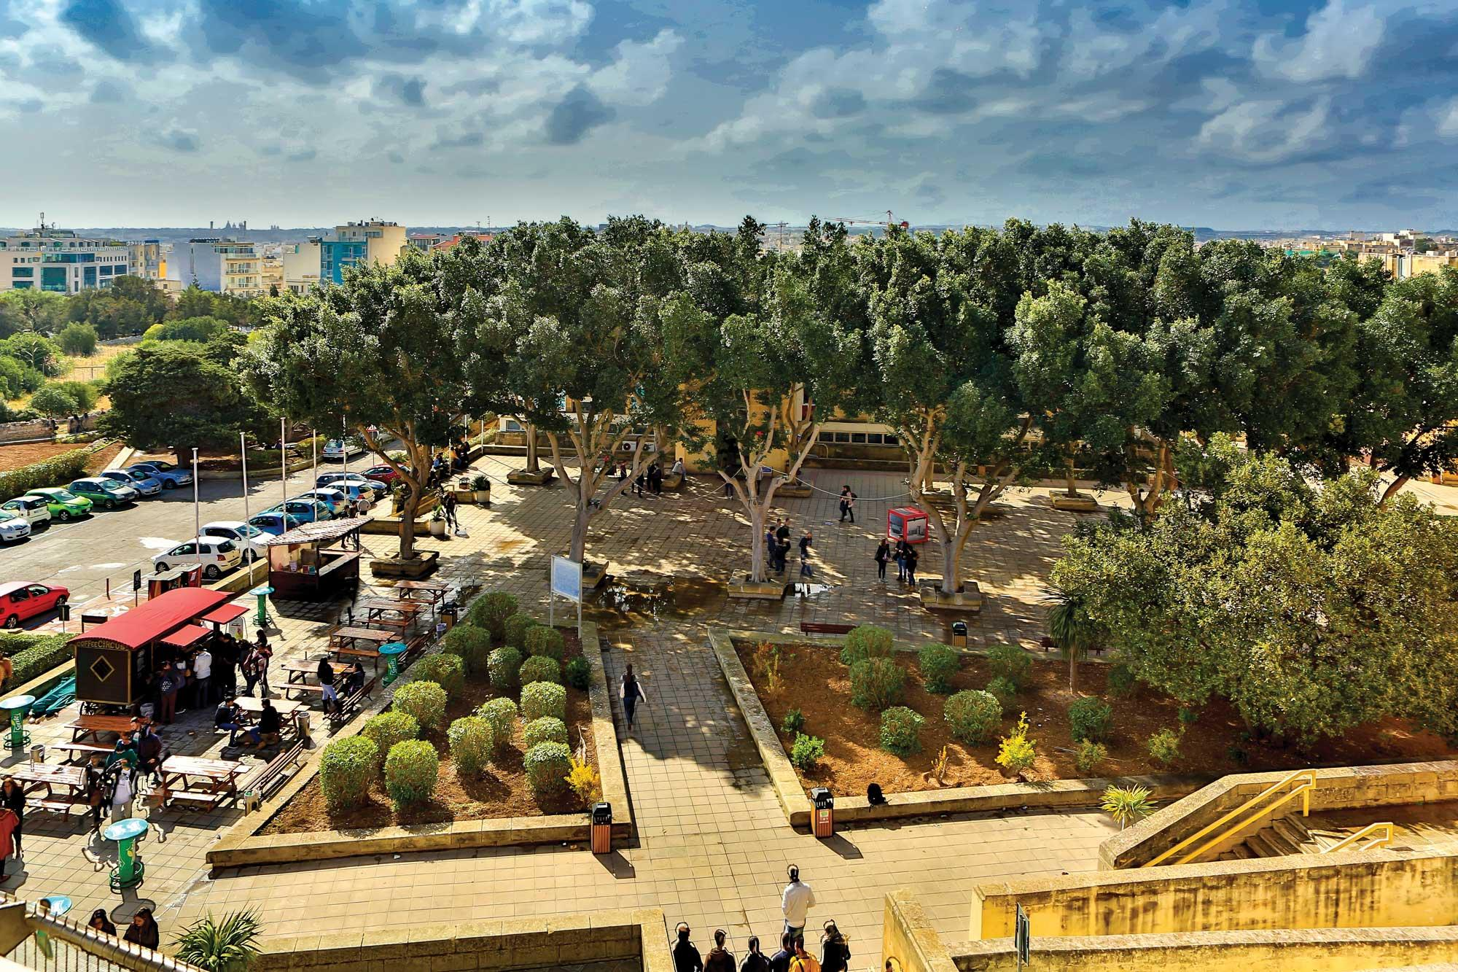





Nov 2026 - University of Crete
Machine Learning for Bioinformatics
Day 3
Transformers
Panagiotis Alexiou, PhD
University of Malta

Slide 2
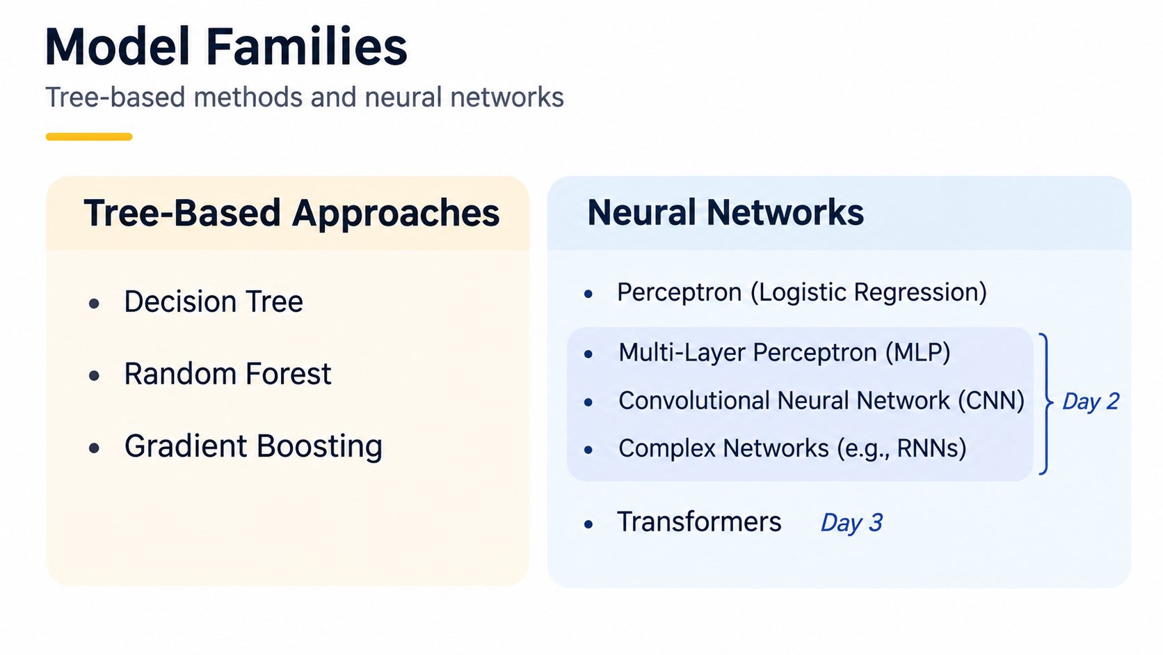


Slide 3
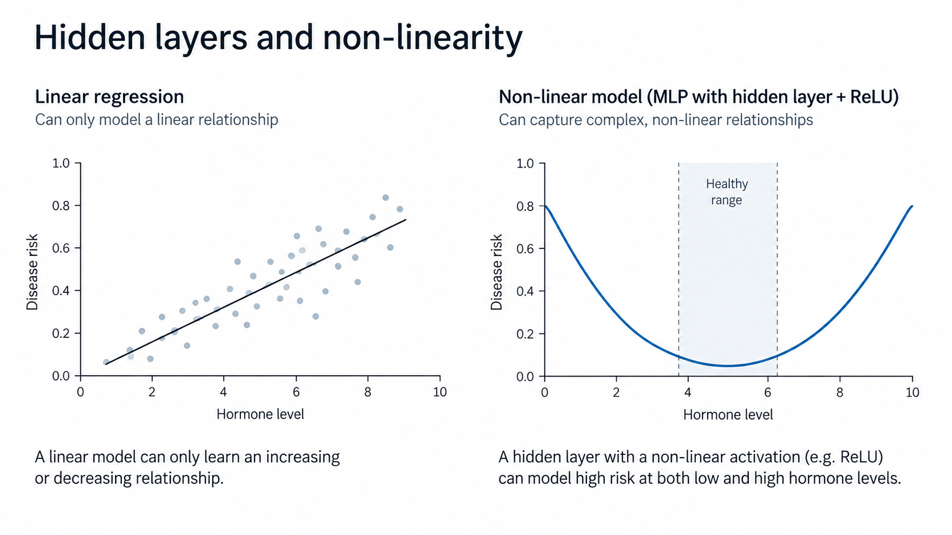
Non-Linearity

Slide 4
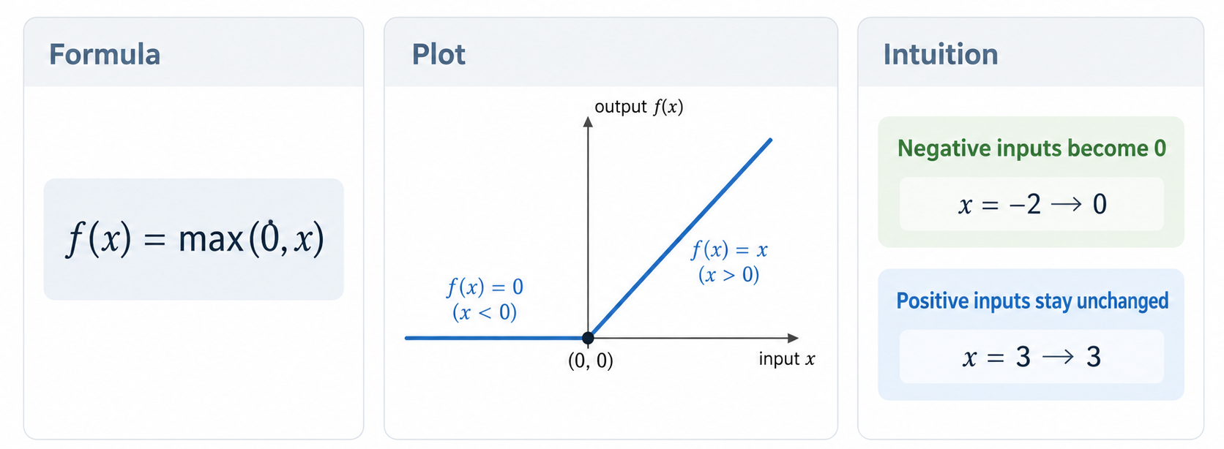
Rectified Linear Unit (ReLU)

Slide 5
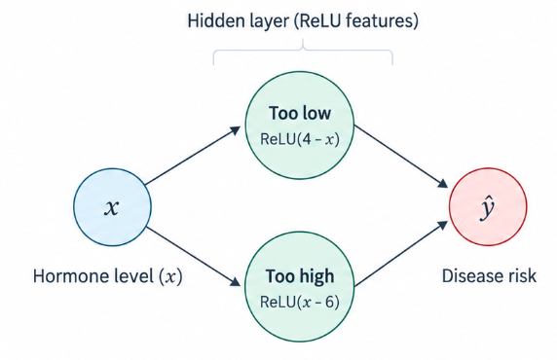
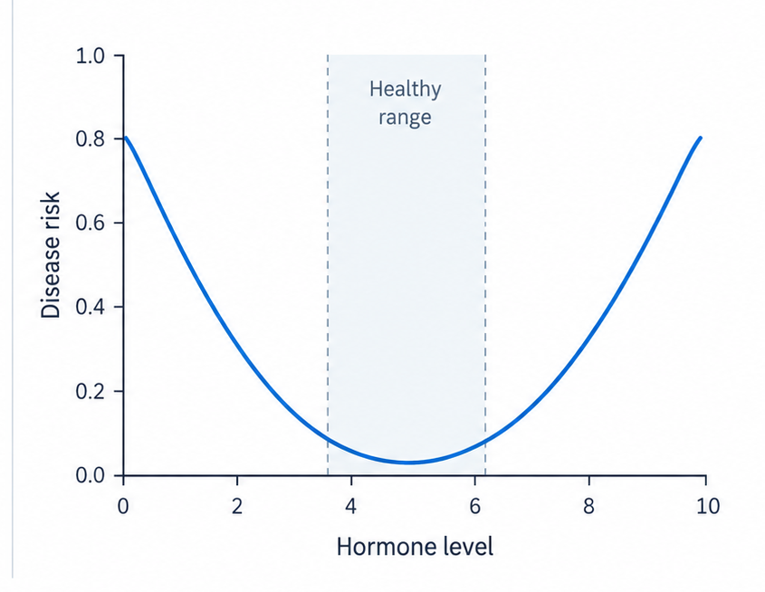
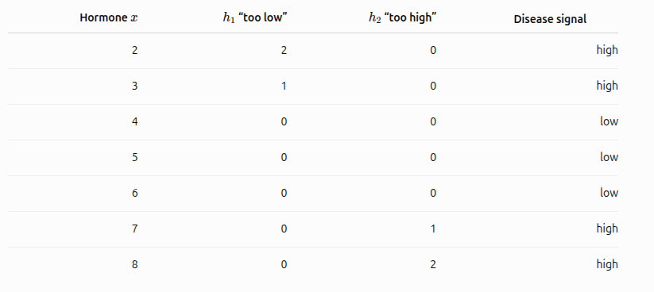
Hidden Layer -> non-linearity

Slide 6
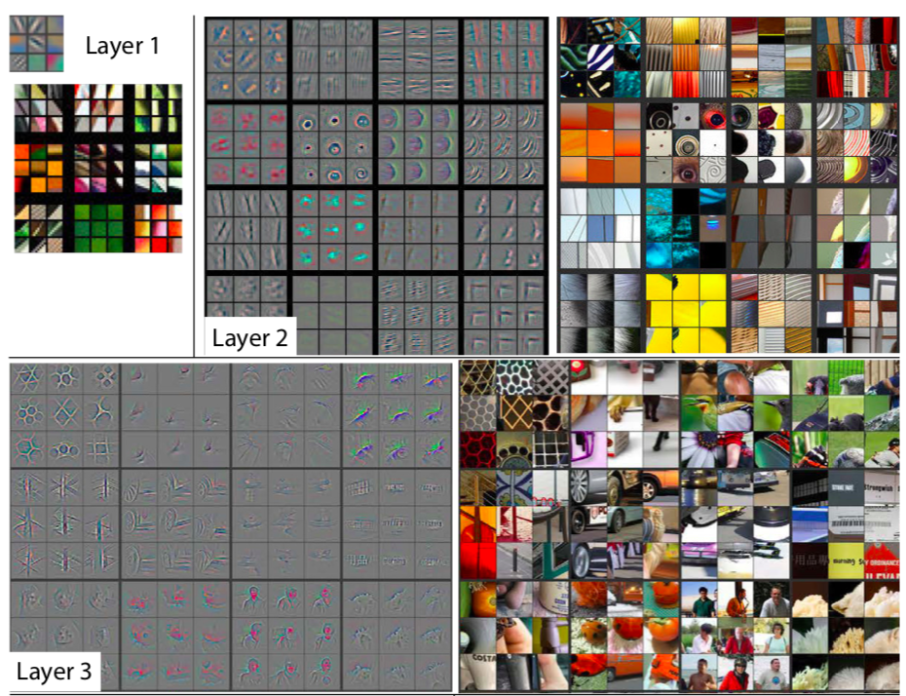
Zeiler, M. D., & Fergus, R. (2014). Visualizing and understanding convolutional networks. In Computer Vision, ECCV 2014

Slide 7
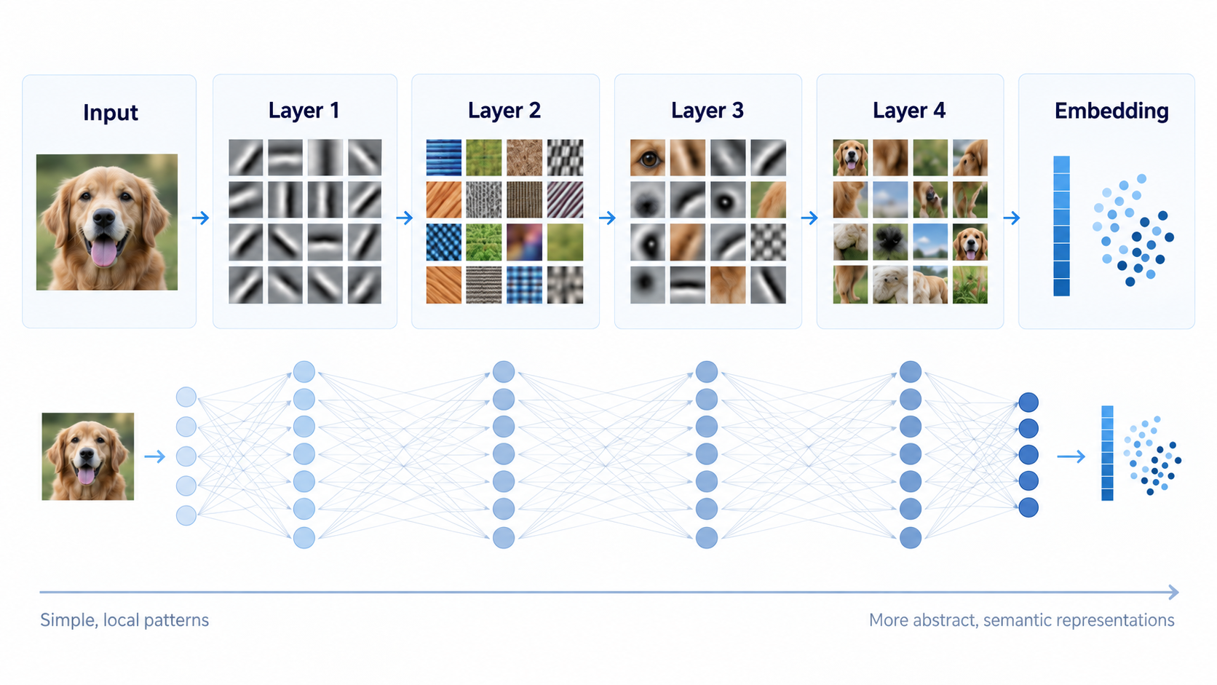

Slide 8
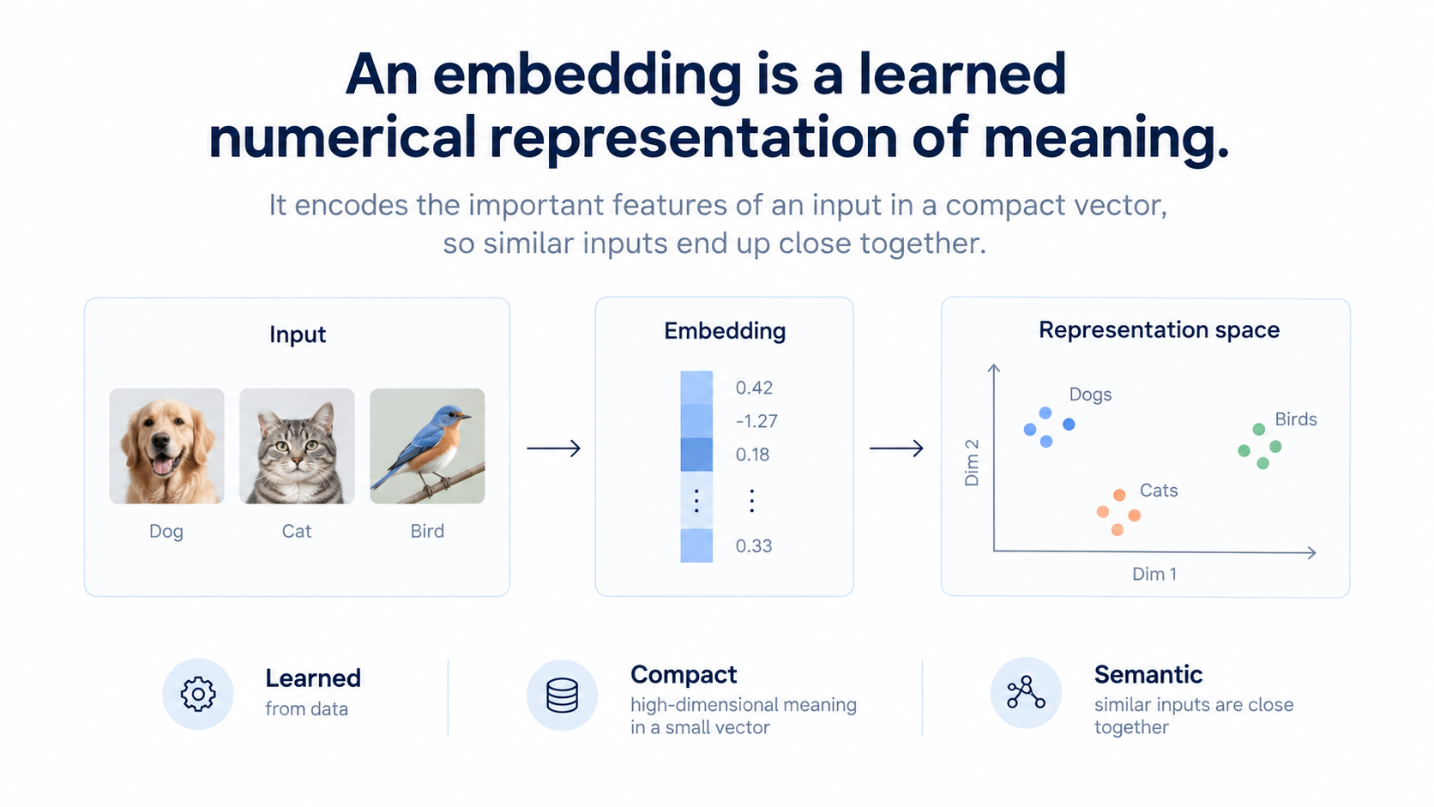

Slide 9
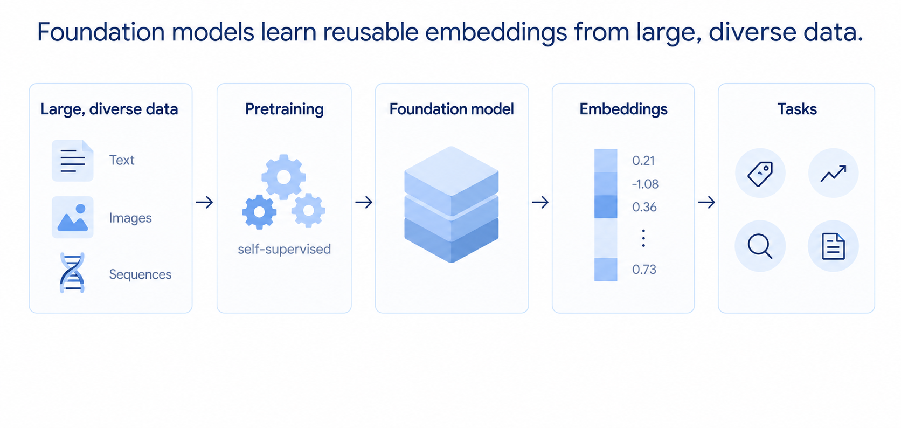

Slide 10
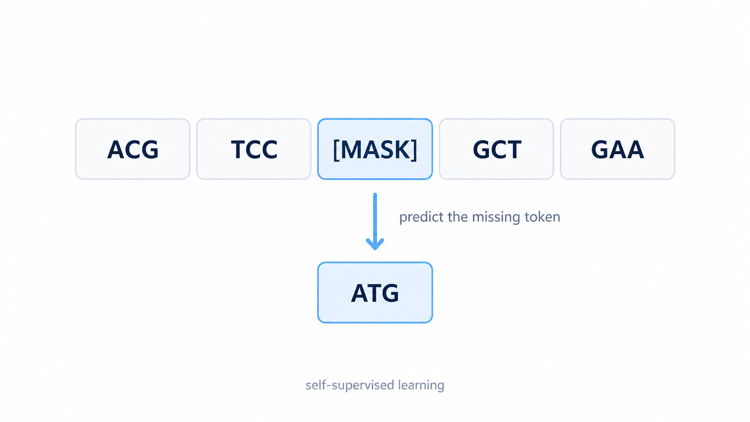
Pre-training a Transformer foundation model

Slide 11
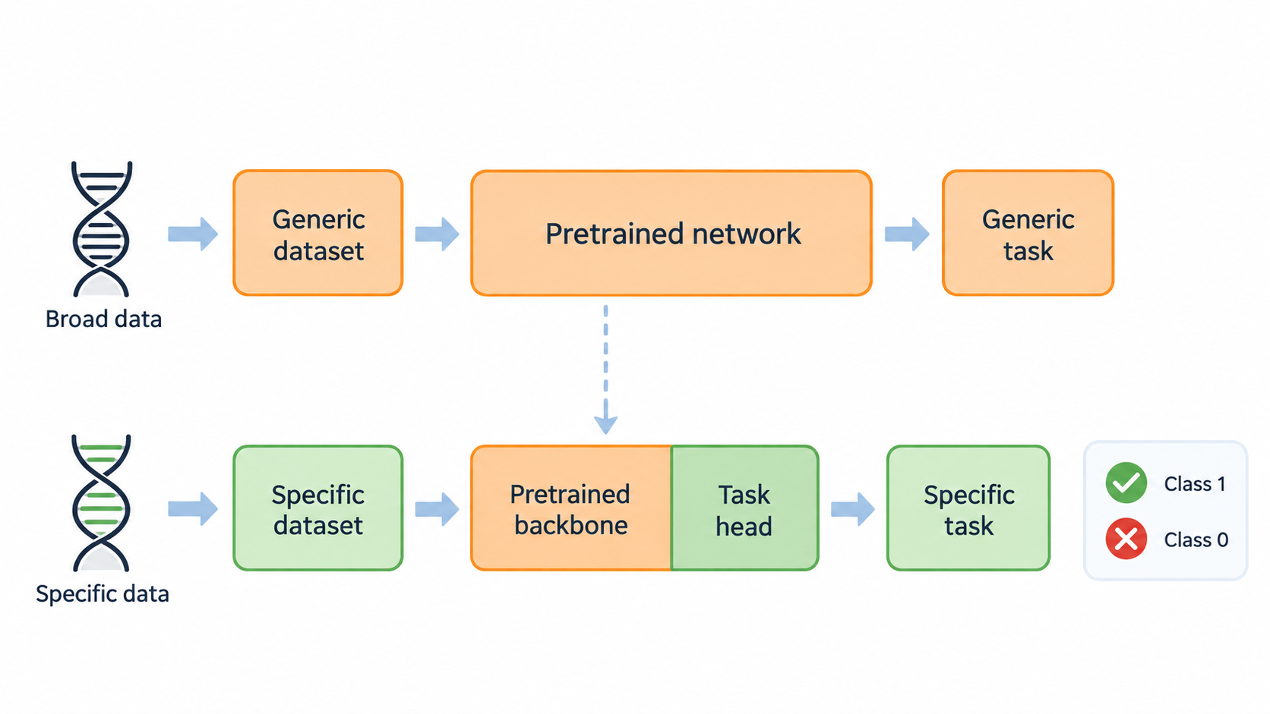
Transfer Learning
Notes:
Imagenet example
Language model’s ‘understanding’

Slide 12
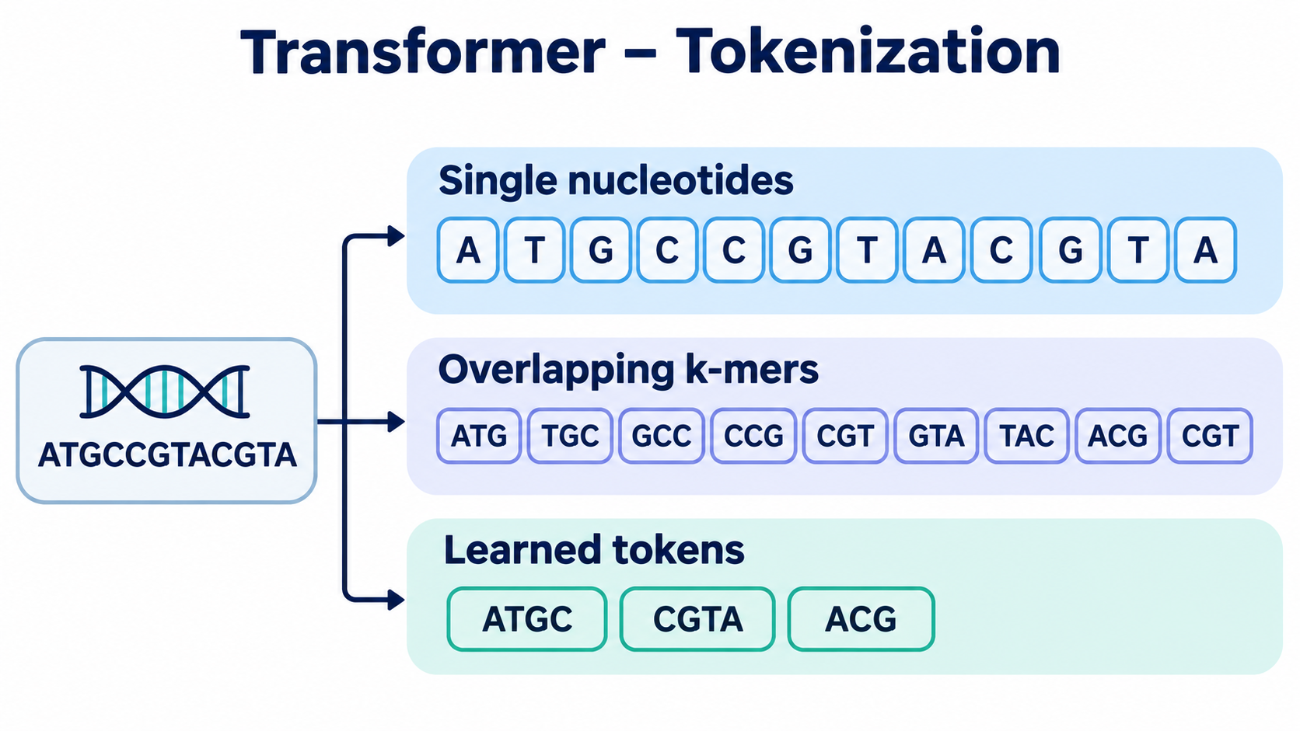
Transformer - Tokenization

Slide 13
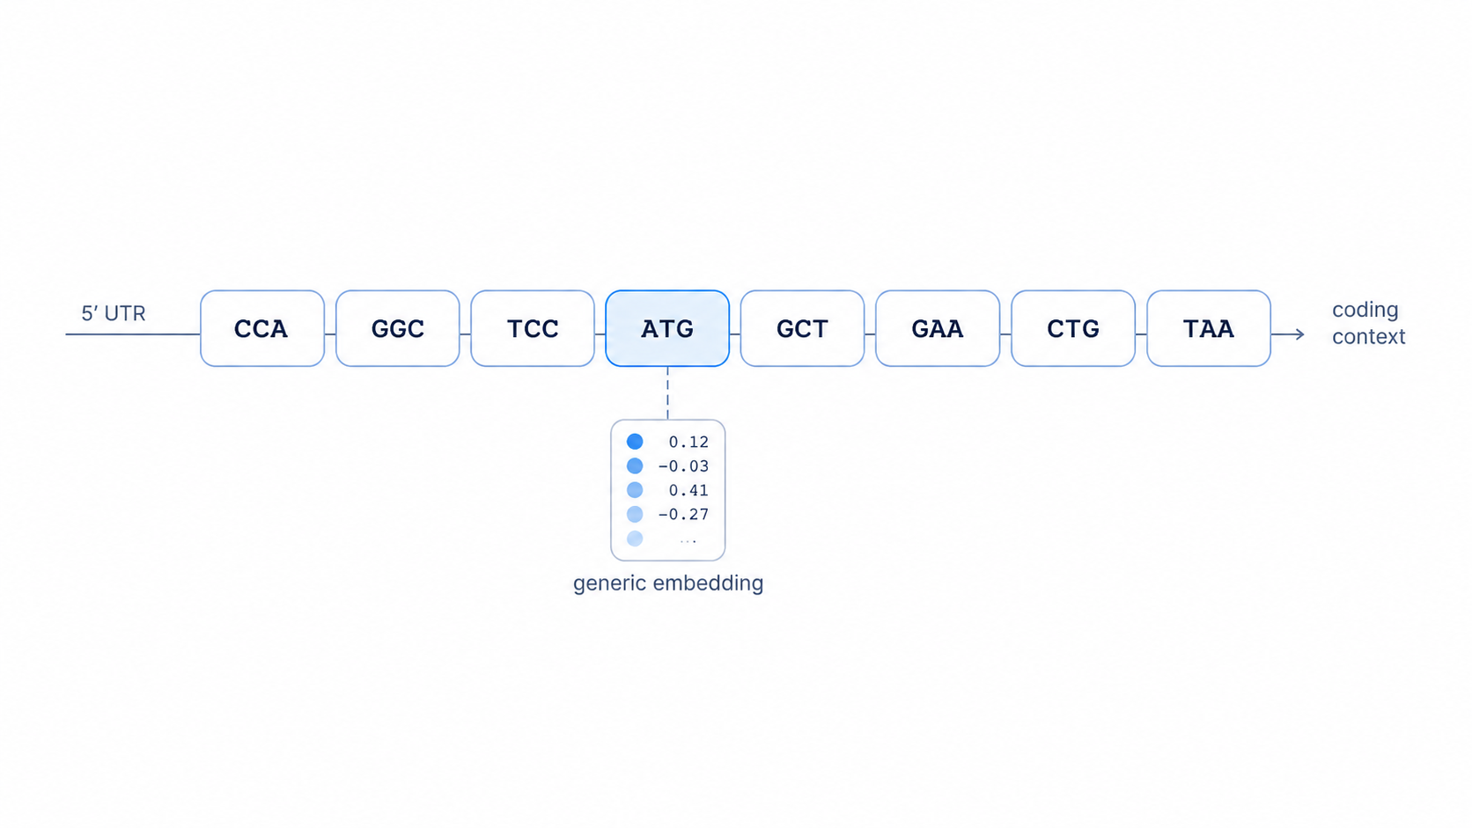
Transformer - Self Attention

Slide 14
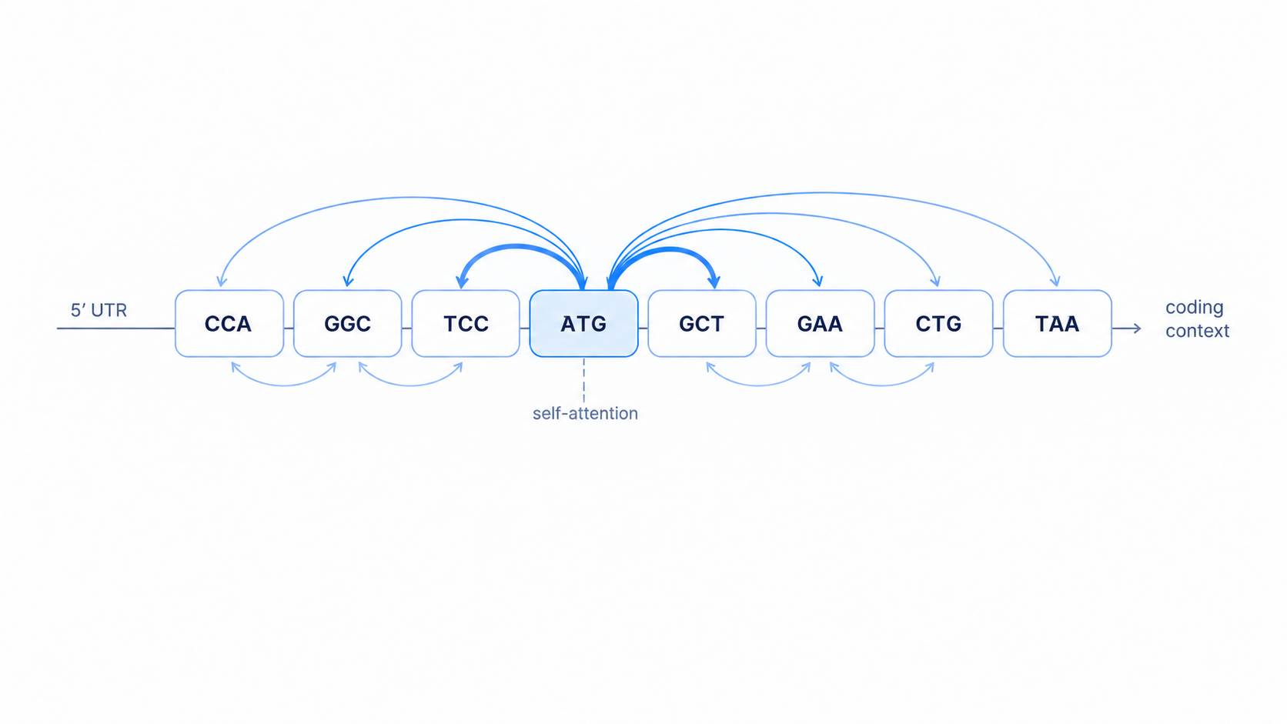
Transformer - Self Attention
Each token attends to other tokens, combining information from across the sequence.

Slide 15
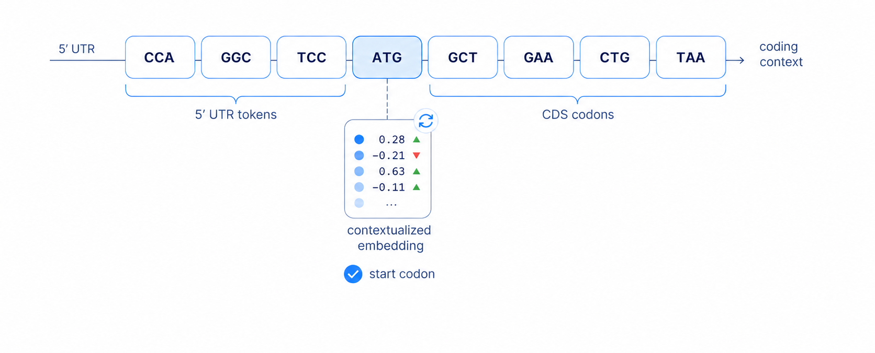
Transformer - Self Attention

Slide 16
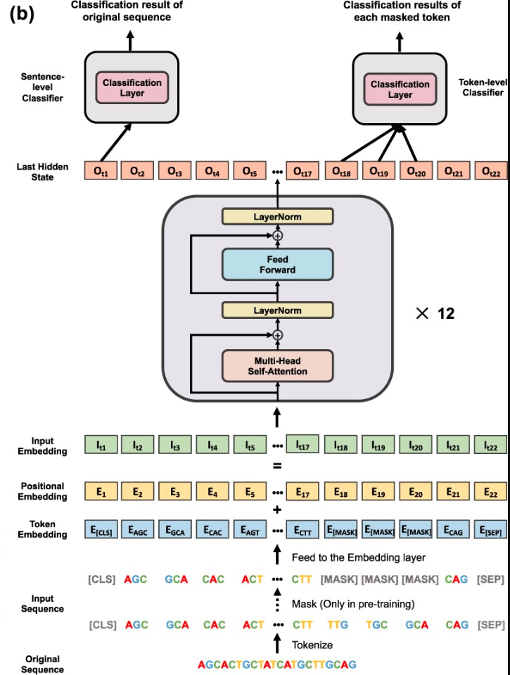
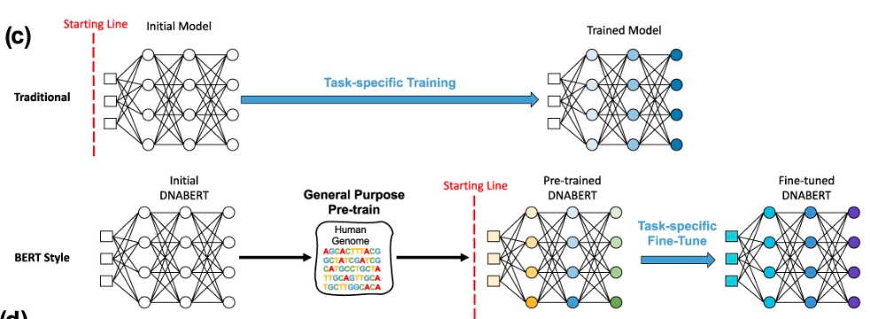
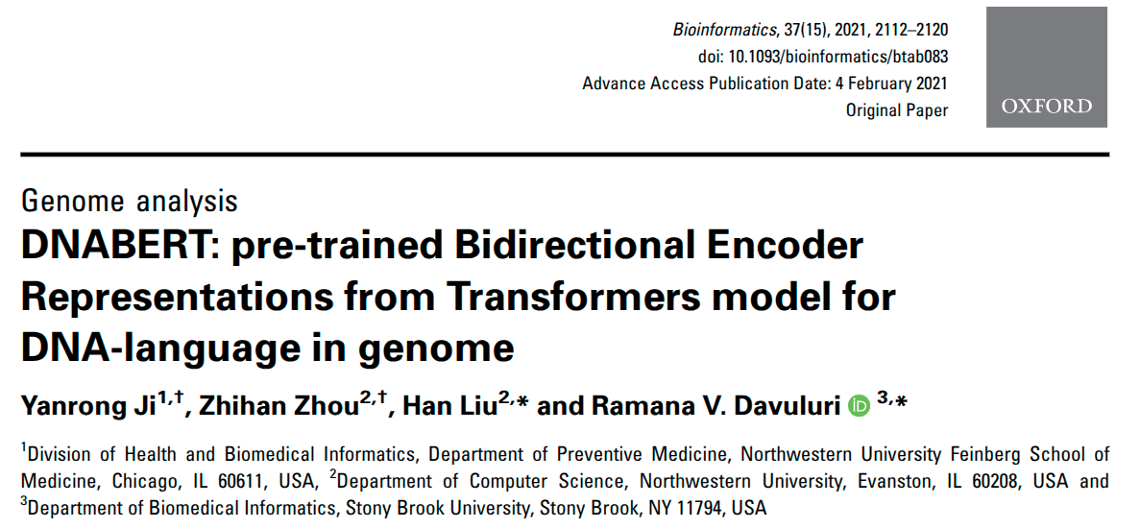

Slide 19
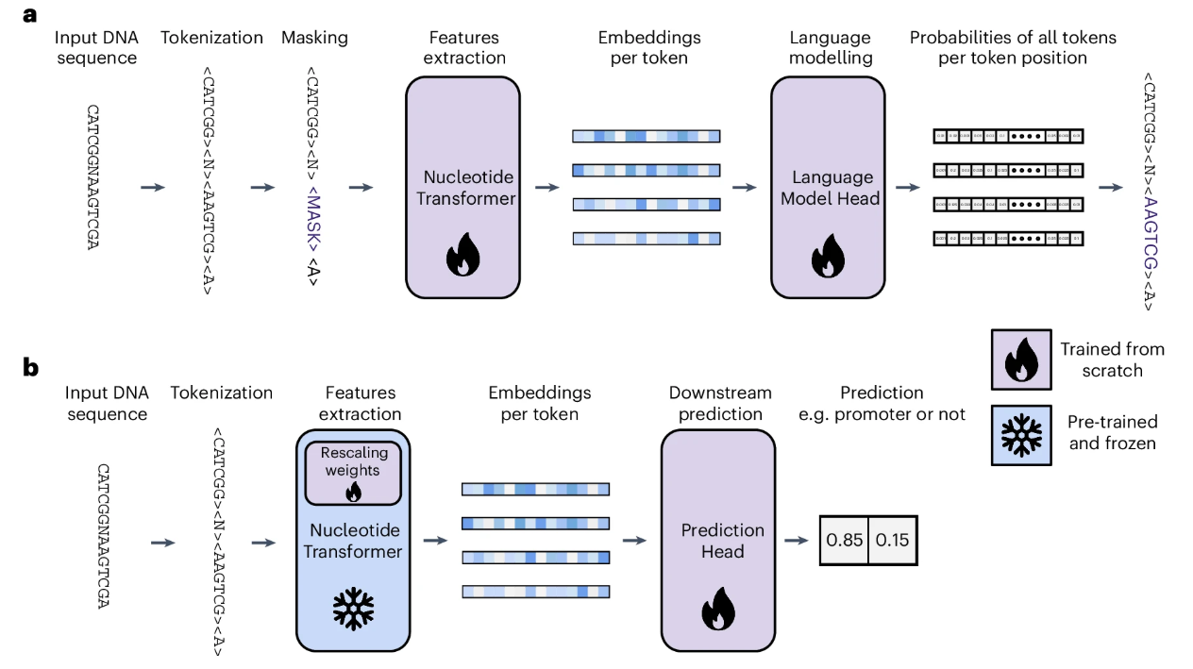
Nucleotide Transformer

Slide 20
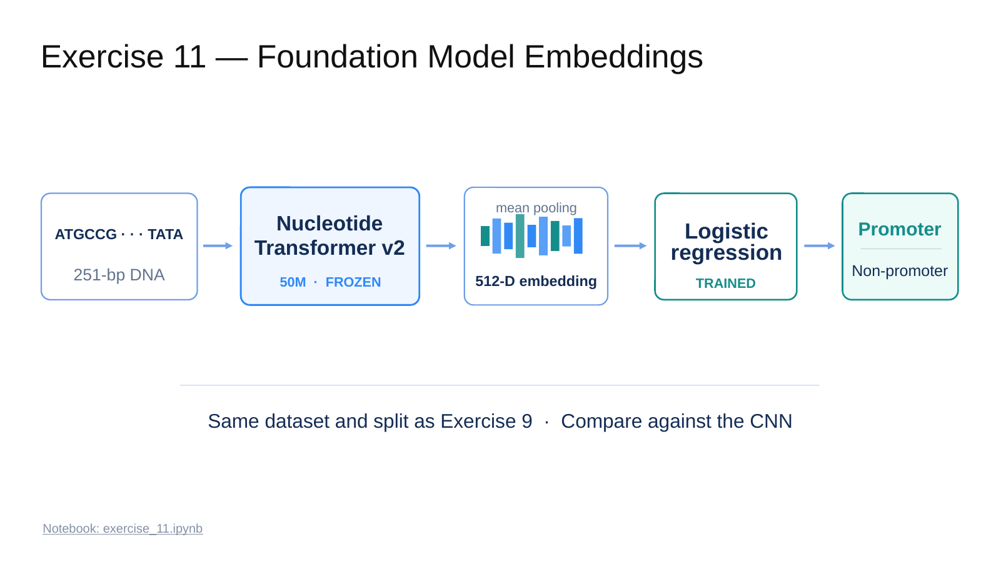

Slide 21
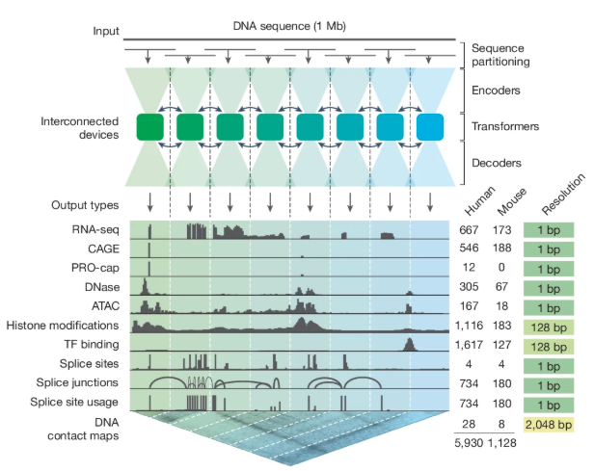
AlphaGenome
U-net like architecture
Multitask seq to function

Slide 22
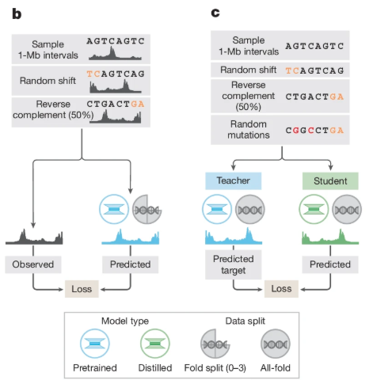

Slide 23
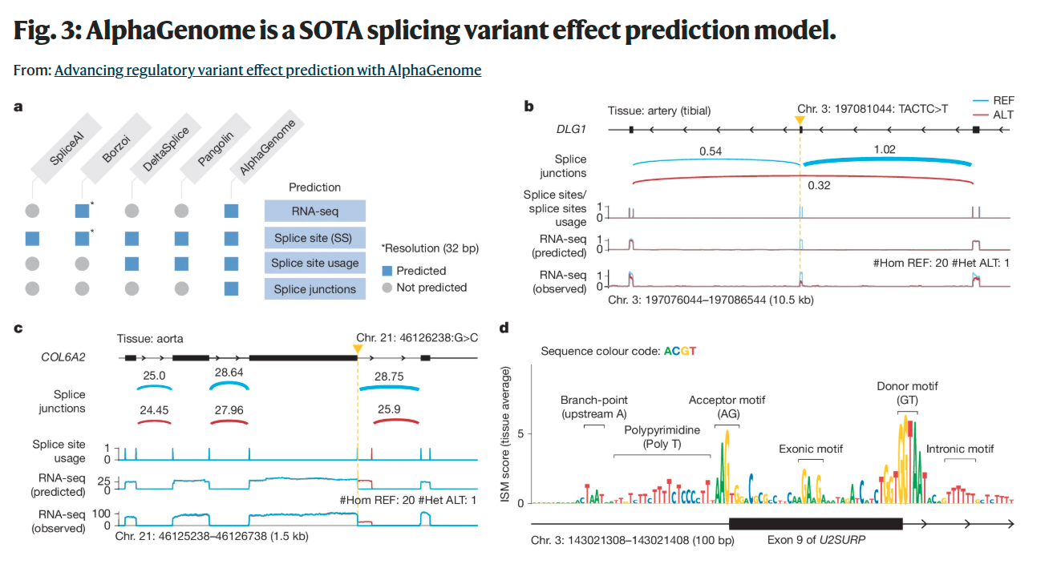

Slide 24
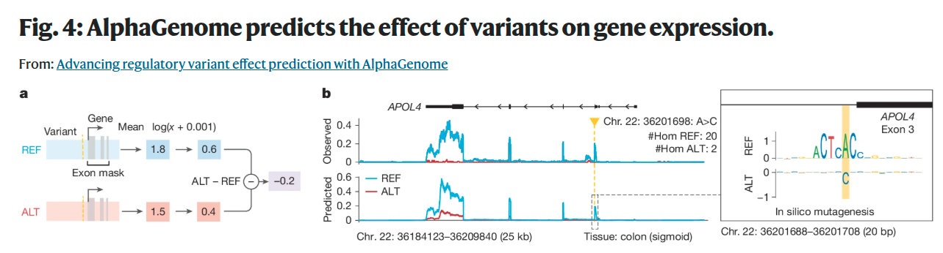
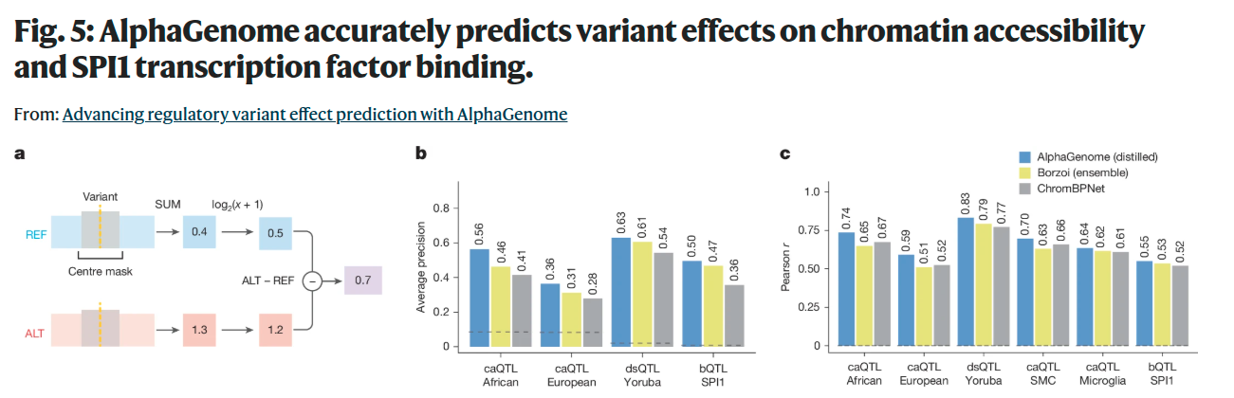

Slide 25


